Slide 1

✈
Machine Learning · 2026
ADS-B & ADS-C Trajectory Fusion
Gap-Filling and Route Analytics over the North Atlantic
John El Hachem · Samir Jabara · Charbel Mouawad
UNIVERSITÉ SAINT-JOSEPH DE BEYROUTH · ESIB
Notes:
Good afternoon. I'm John El Hachem, and together with Samir Jabara and Charbel Mouawad, we present AeroFusion — our machine learning pipeline for reconstructing aircraft trajectories over the North Atlantic. Let me start with the problem we set out to solve.

Slide 2
OVERVIEW
Presentation Overview
✈ Part 01
✈ Part 02
✈ Part 03
The Problem
Operational Impact
Data Sources
8-Step Pipeline
Three Methods
GRU Architecture
Results & Charts
Live Demo
Conclusion
SLIDES 1 – 5
SLIDES 6 – 10
SLIDES 11 – 15
Notes:
Here's how our presentation is structured. I'll cover the problem, data, and pipeline. Samir will walk you through the three reconstruction methods and our GRU architecture. Charbel will close with results, the live demo, and conclusions.

Slide 3
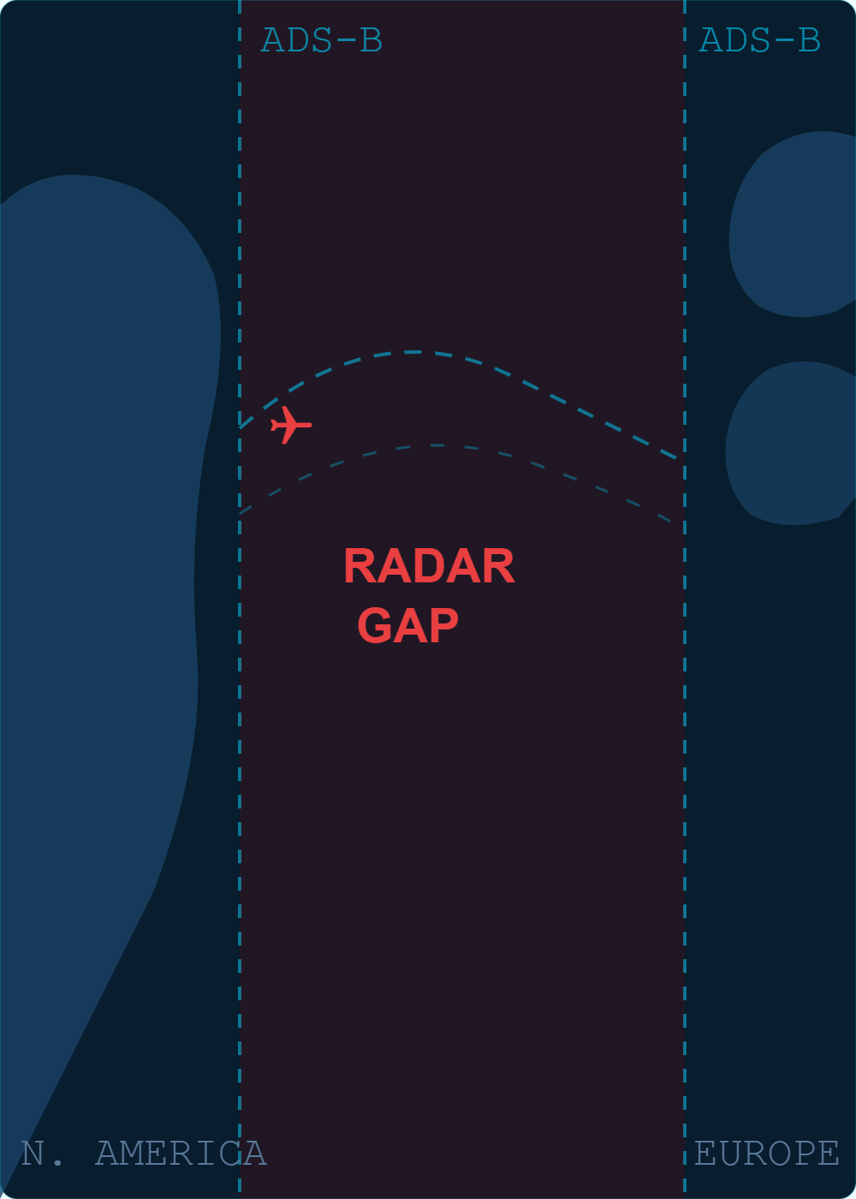
THE PROBLEM
Aircraft Disappear Over the Atlantic
239'
400+
0
average radar blackout per crossing
daily flights cross the blind spot
real-time positions available mid-ocean
Beyond 15°W (Irish coast), ADS-B radar reaches no further. Controllers must rely on procedural separation — time-based estimates, not real positions.
Notes:
The core problem: once a flight crosses 15 degrees west longitude — roughly the Irish coast — it disappears from ADS-B radar entirely. The average blackout lasts nearly four hours. Over 400 flights per day cross this blind spot, and controllers have zero real-time position data during this time.

Slide 4
OPERATIONAL IMPACT
The Operational Impact
TODAY — WITHOUT RECONSTRUCTION
WITH TRAJECTORY RECONSTRUCTION
Position estimates only — no real-time fix
Separation based on time, not distance
Safety margins inflated to compensate
Fuel burn not optimized — fixed NAT tracks
Incident detection delayed by minutes
64 km median position estimate — not zero
Tighter separation becomes achievable
Safety margins can be reduced intelligently
Jet-stream routing awareness unlocked
Historical analytics for route optimization
✈ Every km of error reduction translates to tighter separation standards and safer, more efficient oceanic crossings
Notes:
This isn't just an academic gap. Today, controllers must use procedural separation — time-based, not position-based — with inflated safety margins. With accurate trajectory reconstruction, we could enable tighter separation and more fuel-efficient routing.

Slide 5
DATA SOURCES
Two Complementary Surveillance Sources
ADS-B
ADS-C
VALIDATED
OpenSky Network Trino Database
Satellite Relay Trino adsc table
1,704
NAT crossings
FREQUENCY
~1 / second
FREQUENCY
10 – 40 min
COVERAGE
Continental only
COVERAGE
Full oceanic
BLACKOUT AVG
239'
PERIOD
Jul 2023 – Aug 2025
WAYPOINTS
5 – 8 per flight
ROLE
Coastal anchors
Ground truth ★
min per crossing
ROLE
Notes:
We combined two sources. ADS-B from OpenSky gives us dense, one-per-second reports over land — our coastal anchors. ADS-C via satellite gives sparse oceanic reports every 10 to 40 minutes — our ground truth. Together, across two years of data, we validated 1,704 complete North Atlantic crossings.

Slide 6
METHODOLOGY
8-Step Machine Learning Pipeline
01
›
02
›
03
›
04
›
05a
›
06
›
07
›
08
Ingest
Clean
Baseline
ML Dataset
Kalman
Analytics
API
Monitor
Raw Trino queries
1,704 flights
131 km
1,094 / 189 / 240
83 km −37%
Test evaluation
FastAPI
Dashboard
05b
GRU
64 km −51%
GRU RESULT
64 km −51%
median error vs great-circle baseline
Notes:
I'm Samir Jabara. Our pipeline has eight steps: ingest raw data from Trino, clean and validate, compute a geometric baseline, build the ML dataset, run both Kalman and GRU reconstruction, evaluate analytics, expose via API, and monitor live. The headline: GRU cuts error 51 percent.

Slide 7
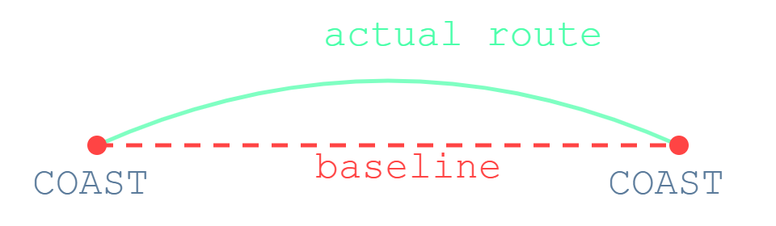
METHOD 01
Great-Circle Baseline
MEDIAN ERROR
131
SLERP interpolation between ADS-B coastal anchors
Draws shortest geodesic path on the sphere
No atmospheric data — ignores jet streams entirely
Zero training required — pure geometry
km
Reference — this is what we beat
"Assumes geodesic path — ignores the jet stream"
Notes:
Our geometric baseline uses SLERP — spherical linear interpolation — between the last ADS-B fix on each coast. It draws a great-circle arc and assumes the aircraft flew straight. It knows nothing about the atmosphere, jet streams, or NAT routing. Median error: 131 kilometers.

Slide 8
METHOD 02
Kalman RTS Smoother
MEDIAN ERROR
83
4-state filter: along/cross-track position & velocity
Physics-based dynamics model
Forward Kalman pass — then backward RTS pass
Non-causal: uses ADS-B data from both coasts
km
−37% vs great-circle baseline
"Physics-based, non-causal smoother"
Forward KF →
+
← RTS Backward
=
Smoothed
along_track
cross_track
v_along
v_cross
Notes:
The Kalman RTS smoother adds physics. We model four state variables: along-track and cross-track position and velocity. A forward Kalman pass is followed by a backward RTS smoothing pass — non-causal, using information from both ends of the gap. Median error: 83 kilometers, a 37 percent improvement.

Slide 9
METHOD 03 ★
GRU Neural Network
ADS-B Before
ADS-B After
64 steps
32 steps
↓
Bidirectional GRU encoder — reads both ADS-B sides
Sequential GRU decoder — outputs waypoint residuals
Residual on great-circle baseline — learns deviations
Haversine loss — geodesic error minimization
Trained on 1,094 real NAT crossings
Bidirectional GRU Encoder
↓
Context Vector
↓
Sequential GRU Decoder
MEDIAN ERROR
↓
64 km
Δlat
Δlon
Δalt
−51% vs great-circle baseline
+ Great-circle baseline = Final prediction
Notes:
Our GRU takes a different approach entirely. We feed it 64 steps of ADS-B before the gap and 32 steps after, encode them with a bidirectional GRU, and decode the oceanic waypoints sequentially. Crucially, we predict residuals on top of the great-circle baseline — the network only needs to learn the deviation, not the absolute path. Trained on 1,094 real crossings.

Slide 10
GRU TRAINING
Training Details
DATASET SPLIT
MODEL CONFIG
TRAIN
1,094 flights
HIDDEN SIZE
160
VALIDATION
189 flights
LAYERS
2 (bidirectional)
240 flights
OPTIMIZER
AdamW
TEST
EARLY STOPPING
Epoch 27
SPLIT STRATEGY
By ICAO24 — no leakage
HARDWARE
Google Colab T4
Split by aircraft identifier ensures no aircraft seen in training appears in the test set
PARAMETERS
693,891
Notes:
Training details: we split by ICAO24 aircraft identifier to prevent any data leakage. 160 hidden units, 2 bidirectional layers, AdamW optimizer. Early stopping triggered at epoch 27. Trained on Google Colab with a Tesla T4 GPU. 693,891 total parameters.

Slide 11
TEST SET PERFORMANCE
240 Unseen Flights — Mean blackout: 239 min
METHOD
MEDIAN
MEAN
P90
IMPROVEMENT
Great-circle
131 km
149 km
355 km
Reference
Kalman RTS
83 km
98 km
222 km
−37%
GRU ★
64 km
84 km
171 km
−51%
GRU achieves 51% median error reduction over naive geometric interpolation
Notes:
I'm Charbel Mouawad. On our held-out test set of 240 flights, the great-circle baseline gives 131 km median error. Kalman improves to 83 km — 37 percent better. Our GRU achieves 64 km — a 51 percent reduction. The 90th percentile drops from 355 to 171 km.

Slide 12
PERFORMANCE COMPARISON
Error Distribution — All 240 Test Flights
MEDIAN ERROR (km)
P90 ERROR (km)
Baseline
131 km
ref
Baseline
355 km
ref
Kalman
83 km
−37%
Kalman
222 km
−37%
GRU
64 km
−51%
GRU
171 km
−52%
Great-circle
Kalman RTS
GRU (ours)
Notes:
Looking at the distribution across all 240 test flights: the GRU consistently outperforms both other methods. The median improvement is 51 percent, but many individual flights see much larger gains — especially on days with strong jet stream activity.

Slide 13
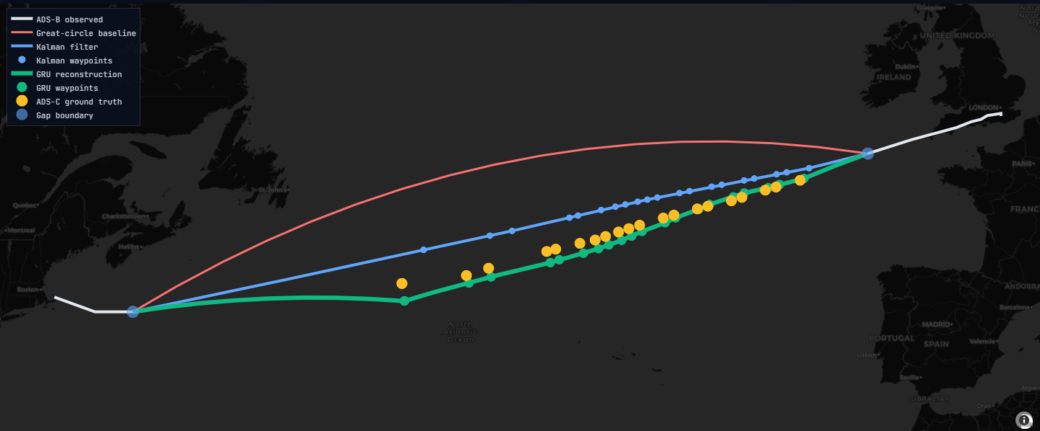
BEST CASE RESULT
Flight BAW2273 01 Aug 2025
BASELINE
→
GRU
IMPROVEMENT
439 km
45 km
+89.7%
"The GRU learned the jet-stream curve the baseline never knew existed."
Notes:
Our best single result: flight BAW2273, British Airways, August 1st 2025. The great-circle was 439 km off. The jet stream pushed this aircraft far north of the direct path. Our GRU reconstructed the trajectory to within 45 km — an 89.7 percent improvement. The network had learned the jet stream. The geometry never could.

Slide 14
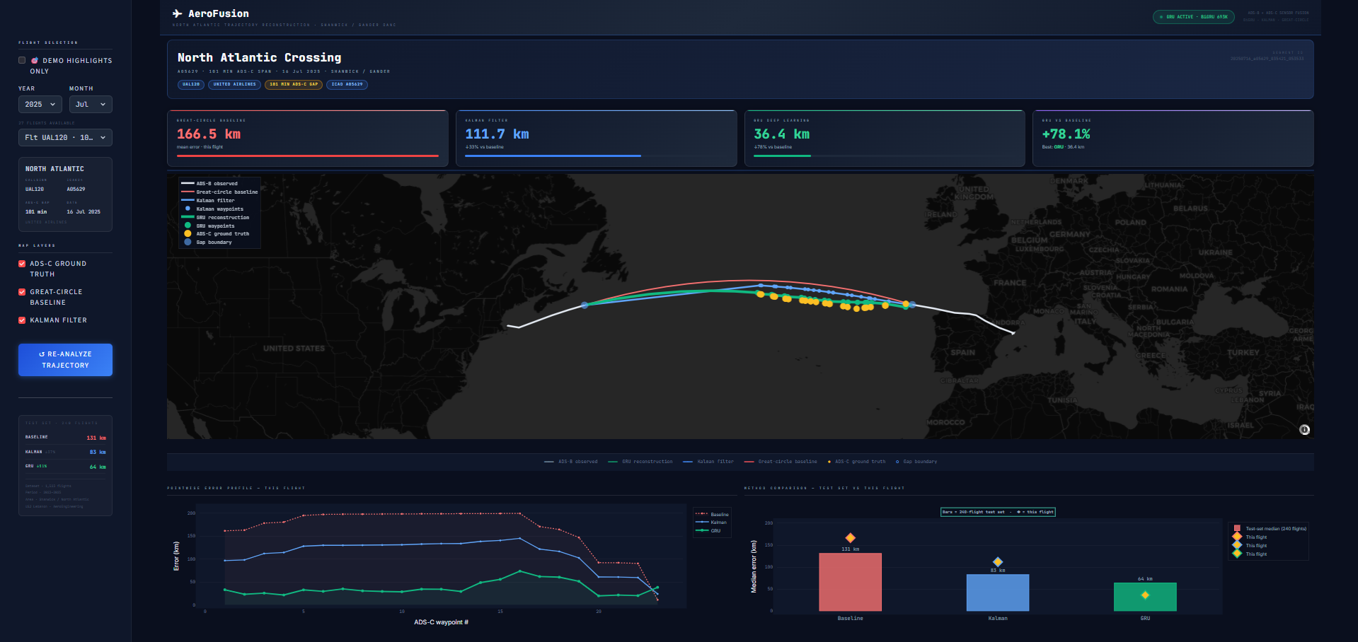
LIVE DEMO
AeroFusion Live Dashboard
● Great-circle
● Kalman
● GRU
✈
All 3 methods on NAT map
📊
Per-flight error metrics
🎯
19 best showcase flights
🐳
docker pull johnelhachem/aeroengineering_ml
Notes:
The AeroFusion dashboard brings it all together. Select any of 10 showcase flights, click reconstruct, and all three trajectories appear on a North Atlantic map. GRU in green, Kalman in blue, baseline in red, ground truth in white. Per-flight metrics update instantly. The whole system runs with one Docker command.

Slide 15
CONCLUSION
What We Built
1,704
51%
64 km
8
validated NAT crossings ingested
median error reduction vs baseline
GRU median error on 240 test flights
pipeline steps from raw data to live API
FUTURE WORK
Pacific & polar corridors
Real-time ATC integration
Ensemble GRU + Kalman
docker pull johnelhachem/aeroengineering_ml
✈ Thank you
Notes:
To summarize: 1,704 validated transatlantic crossings, a GRU model that cuts error 51 percent on 240 unseen flights, a full 8-step pipeline from ingestion to live demo, and a public Docker image for one-command deployment. Future work: Pacific and polar corridors, real-time ATC integration, and a GRU-Kalman ensemble. Thank you — we're happy to take questions.

